Slide 1
CP1404 Module 4B Strings
Process strings, including joining, splitting, slicing, modifying…

Slide 2

Do this later…
Write a function that takes a single "query string" (from a URL) and returns a list of tuples of name-value pairs.
Example:
"?name=Bob&age=99&day=Wed"
should result in a return value of:
[('name', 'Bob'), ('age', 99), ('day', 'Wed')]
For bonus marks* convert any numeric values to numbers.
* There are no bonus marks

Slide 3
Each character in a string has an index (each item in any sequence)
Index | Or | Element
0 | -3 | A
1 | -2 | B
2 | -1 | C
text = "ABC"
Index of the first element (character) in the string is 0,
Negative indexes identify positions relative to the end of the list

Slide 4
Use slicing to access slices of a sequence (string)
Like indexing, slicing works for lists, tuples, strings - any sequence
A slice is a span of items taken from a sequence
Known as a substring for string slices
Slicing format: sequence[start:end]
Expression will return a sequence containing a copy of the elements from start up to, but not including, end (like range)
0 is the default start index
len(string) is the default end index
Slicing expressions can include a 3rd step value (also like range) and negative indexes relative to end of string
Notes:
Demo (before test on next page)

Slide 5
What are these slices (substrings)?
text = "Python" # 6 characters
 | Expression | Value
1 | text[0:4] | Pyth
2 | text[4:7] | on
3 | text[0:-4] | Py
4 | text[0::2] | Pto
5 | text[2:] | thon

Slide 6
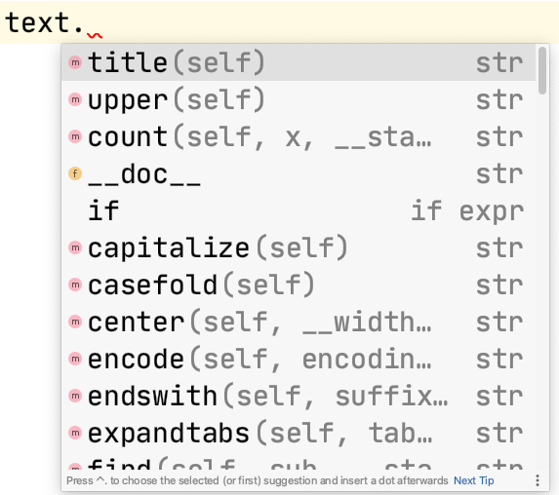
Strings (and most other types) have methods
choice = input("Choice: ").lower() Remember how the dot separates the object (left) from the method (right)
Some useful string methods include
upper(), .lower(), .title() get string in a different case
Press . and view the popup to see more and try them out (in the console)

Slide 7
Python has methods to search for substrings
endswith(substring), startswith(substring): check if the string ends or starts with substring
find(substring): searches for substring within the string
Returns lowest index of the substring, or if the substring is not contained in the string, returns -1
if subject_code.startswith("CP"): print("That's an IT subject :)")

Slide 8
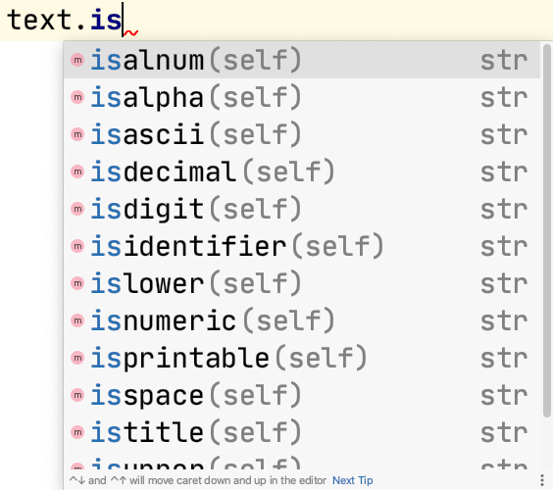
Test if a string is… something with these methods
phone_number = input("Phone: ") if not phone_number.isdigit(): print("Invalid phone number")
name = input("Name: ") if not name.isalpha(): print("Alphabetical only")
expression = input("Say something: ") if expression.isupper(): print("No need to shout")
These are often/usually used per character.

Slide 9
Use "in" to determine if a substring is in a string
The in and not in operators can be used for searching a collection
if "CP" in subject_code: print("You are cool") if needle not in haystack: print(value, "is not found")
"ab" in "able" # True "AB" in "Able" # False

Slide 10
Don't use "in" to check equality
The in and not in operators are for looking "in", not comparing to
if required_password in your_password: print("Access granted!")
Oh no! "secret" in "not_secret" # True "secret" == "not_secret" # False

Slide 11
''.join() is preferred over string concatenation
+ is the "concatenation" operator for strings
+= adds to the end of a string
''.join([s1, s2]) joins two strings, s1 and s2
See PEP8 "Programming Recommendations":
"… do not rely on CPython’s efficient implementation of in-place string concatenation for statements in the form a += b or a = a + b. … In performance sensitive parts of the library, the ''.join() form should be used instead. This will ensure that concatenation occurs in linear time across various implementations."
Notes:
https://peps.python.org/pep-0008/#programming-recommendations

Slide 12

Do this now
Write a function that takes a single "query string" (from a URL) and returns a list of tuples of name-value pairs.
Example:
"?name=Bob&age=99&day=Wed"
should result in a return value of:
[('name', 'Bob'), ('age', 99), ('day', 'Wed')]
For bonus marks* convert any numeric values to numbers.
* There are no bonus marks

